Slide 1
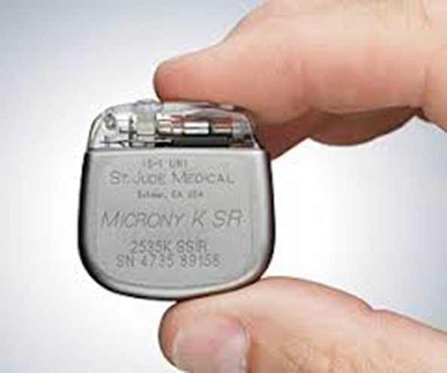
Pacemaker
principles of operation
function
use
scientific principles
construction
components
system diagram
inputs/outputs
18.1.6 Pacemaker
Unit C 18.1 Maintaining cardiovascular and monitoring equipment
Module 279 19 C Medical Instrumentation II
©
dr. Chris R. Mol, BME, NORTEC, 2017

Slide 2
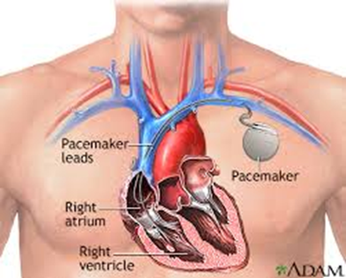
Function
A pacemaker (or artificial pacemaker, so as not to be confused with the heart's natural pacemaker) is a medical device which uses electrical impulses, delivered by electrodes contracting the heart muscles, to regulate the beating of the heart.
The primary purpose of a pacemaker is to maintain an adequate heart rate, either because the heart's natural pacemaker is not fast enough, or because there is a block in the heart's electrical conduction system.
Modern pacemakers are externally programmable and allow a cardiologist to select the optimum pacing modes for individual patients. Some combine a pacemaker and defibrillator in a single implantable device. Others have multiple electrodes stimulating differing positions within the heart to improve synchronisation of the ventricles of the heart.
©
Pacemaker
dr. Chris R. Mol, BME, NORTEC, 2017

Slide 3
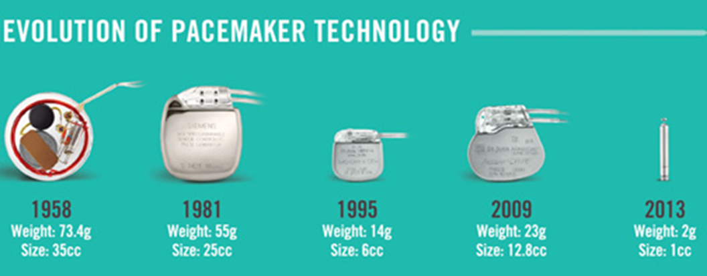
Pacemaker history: miniaturization
The size of pacemakers has been reduced over time (miniaturization).
The newest pacemakers are so small that they fit into the heart and do not require leads.
©
History of Medical Equipment Innovation
dr. Chris R. Mol, BME, NORTEC, 2017

Slide 4
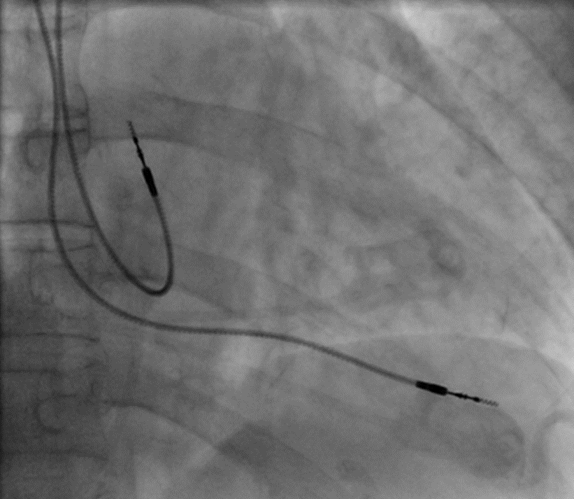
Use: insertion
A pacemaker is typically inserted into the patient through a simple surgery using either local anesthetic or a general anesthetic. An antibiotic is typically administered to prevent infection.
In most cases the pacemaker is inserted in the left shoulder area where an incision is made below the collar bone creating a small pocket where the pacemaker is actually housed in the patient's body.
The lead(s) are fed into the heart through a large vein using an X-ray system to monitor the progress of lead insertion. The actual surgery may take about 30 to 90 minutes.
©
Pacemaker
dr. Chris R. Mol, BME, NORTEC, 2017

Slide 5
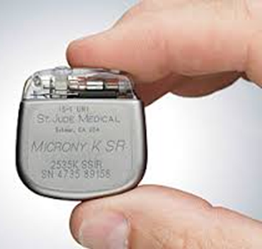
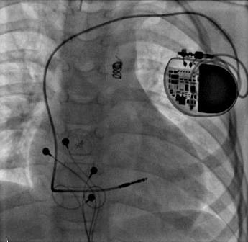
Use: insertion
X-ray image with pacemaker
In a follow-up session after the surgery, the pacemaker is checked using a "programmer" that communicates with the device and allows the evaluation the system's integrity and application of settings such as
pacing voltage output.
©
Pacemaker
dr. Chris R. Mol, BME, NORTEC, 2017

Slide 6
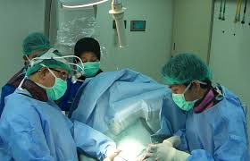
Use
Since a pacemaker uses batteries, the device will need replacement as the batteries lose power. Device replacement is usually a simpler procedure than the original insertion as it does not normally require leads to be implanted.
The typical replacement requires a surgery in which an incision is made to remove the existing device, the leads are removed from the existing device, the leads are attached to the new device, and the new device is inserted into the patient's body replacing the previous device.
©
Pacemaker
dr. Chris R. Mol, BME, NORTEC, 2017

Slide 7
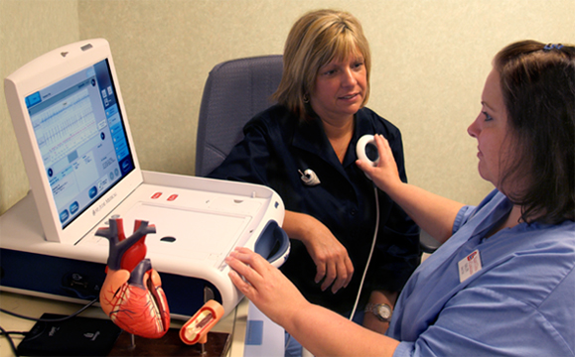
Scientific Principles
Many advancements have been made to improve the control of the pacemaker once implanted. Many of these have been made possible by the transition to microprocessor controlled pacemakers.
Pacemakers that control not only the ventricles but the atria as well have become common. Pacemakers that control both the atria and ventricles are called dual-chamber pacemakers. Although dual-chamber models are more expensive, timing the contractions of the atria to precede that of the ventricles improves the pumping efficiency of the heart which is useful in some heart diseases.
programming a pacemaker after implantation
Modern pacemakers include sensors to measure the patient’s own cardiac activity (atrial and ventricular depolarization). The pacing rate is then adapted to this. The pace maker does not pace when the patient’s heart performs well without its help.
©
Pacemaker
dr. Chris R. Mol, BME, NORTEC, 2017

Slide 8
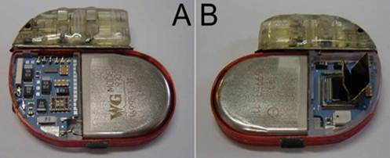
Construction
A pacemaker after the removal of its titanium housing (front and back).
The battery occupies 60% of its size. The electronic circuits are assembled in multilayer. The complete device weights 26 grams
©
Pacemaker
dr. Chris R. Mol, BME, NORTEC, 2017

Slide 9
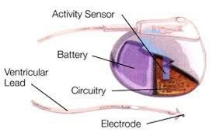
Components
A pacemaker consists of the following components:
the metal encasement of the electronic circuit,
the electronic circuitry (including an ultra low power microcontroller)
the battery
(a sensor to sense patient activity)
one or more leads to conduct electrical impulses to the heart muscle.
A connector block, made of polyurethane, is located at the top of the pacemaker. It serves to attach the pacemaker to the pacemaker lead. The pulse generator is encased in titanium. Titanium helps to shield the internal components and reduces external electromagnetic interference (safety).
©
Pacemaker
dr. Chris R. Mol, BME, NORTEC, 2017

Slide 10
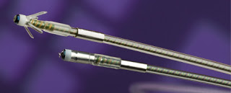
Components: leads
One or two leads may be used, depending on the type of pacemaker. The lead is an insulated wire consisting of a connector pin, lead body, fixation mechanism and at least one electrode. The connector pin is the portion of the lead that is inserted into the connector block.
The lead body is the insulated metal wire that carries electrical energy from the pacemaker to the heart. The lead must be able to withstand the flexing induced by the cardiac contractions in the warm and corrosive environment in the body. Thus, the materials used must be inert, nontoxic, and durable.
The fixation mechanism serves to hold the tip of the lead in place in the heart. Currently, either a nickel-cobalt alloy with a silver core helix or an electrically active platinum-iridium helix may be used to anchor the electrode of the lead to the surface of the heart
©
Pacemaker
dr. Chris R. Mol, BME, NORTEC, 2017

Slide 11
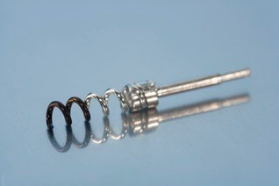
Components: leads
The electrode is located at the tip of the lead. It serves to deliver the electrical energy from the pacemaker to the heart and information about the natural activity of the heart back to the pacemaker. Electrodes may be composed of platinum, titanium, stainless steel, silver, or cobalt alloys.
©
Pacemaker
dr. Chris R. Mol, BME, NORTEC, 2017

Slide 12
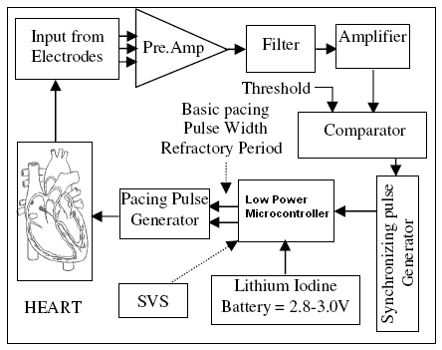
System Diagram
Diagram of a modern pace maker. It uses the input from electrodes/leads to measure the activity of the heart and adapt the pacemaker rate to this.
A voltage pulse of 5 to 7.5 Volts is delivered to the heart through the pacing electrodes. The amplitude and pulse width must be customized for each patient.
The Supply Voltage Supervisor (SVS) monitors the battery voltage.
©
Pacemaker
dr. Chris R. Mol, BME, NORTEC, 2017

Slide 13
END
The creation of this presentation was supported by a grant from THET:
see https://www.thet.org/

